Slide 1
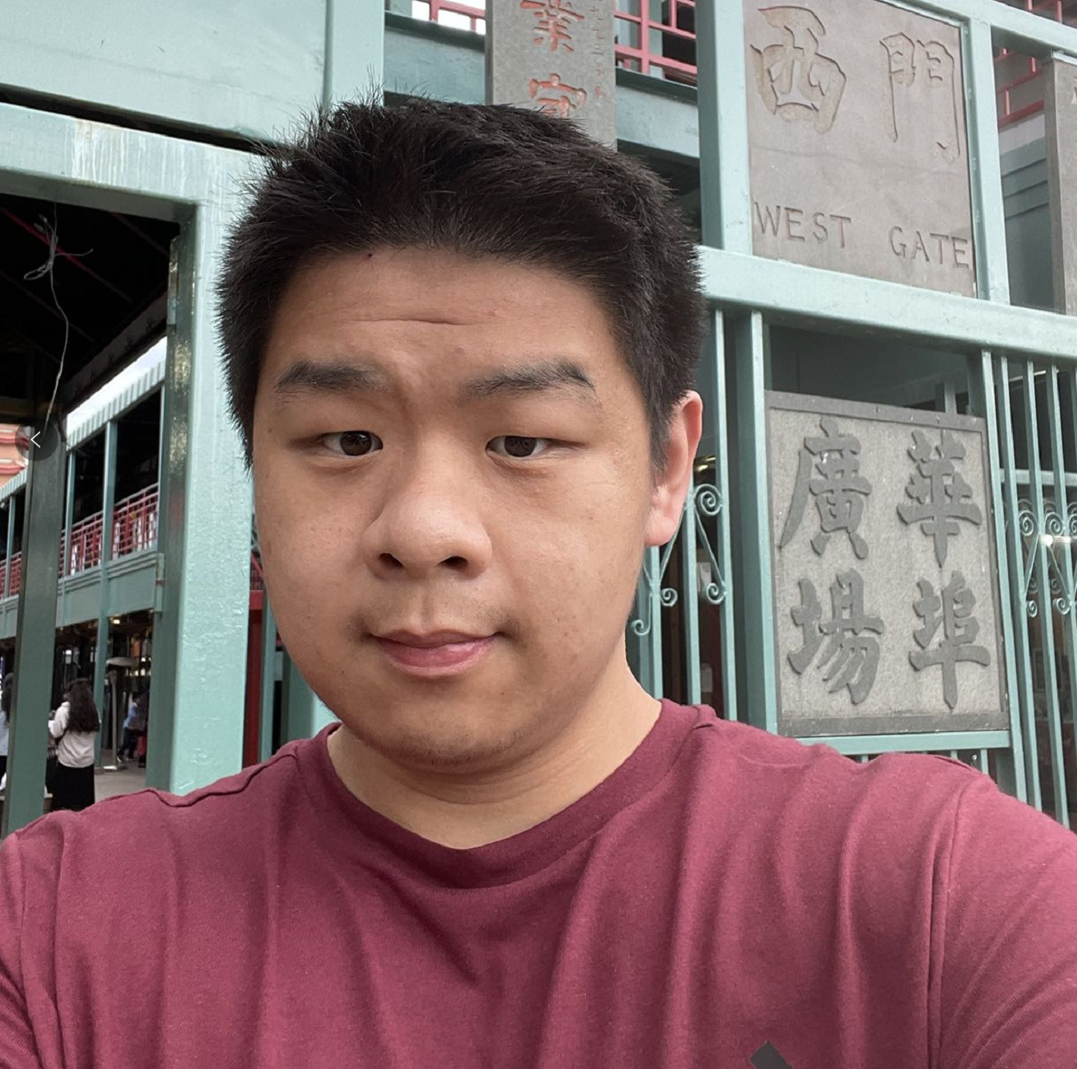
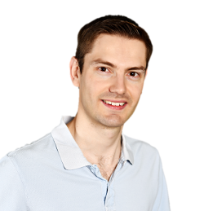
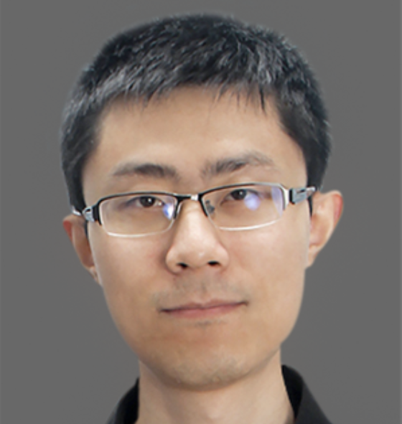
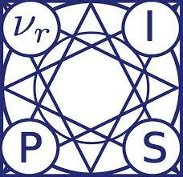
Reinforcement Learning Gradients as
----- - for Online Finetuning Decision Transformers
NeurIPS 2024 Spotlight
Kai Yan, Alexander G. Schwing, Yu-Xiong Wang
University of Illinois Urbana-Champaign
Vitamin
Notes:
Hi I’m Kai Yan, and I will tell you about our spotlight paper “Reinforcement Learning Gradients as Vitamin for Online Finetuning Decision Transformers”.
”

Slide 2
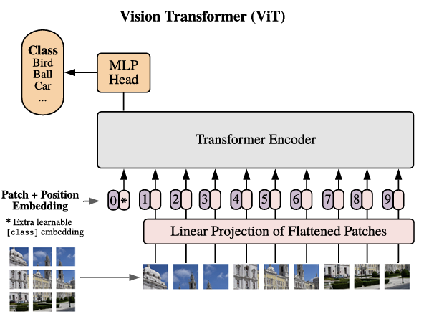
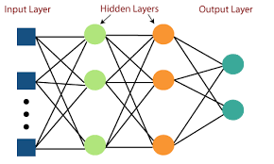
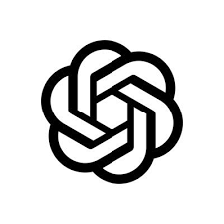
Catching up with the Transformer Age
Language and Vision communities have much benefitted from scaling…
But Reinforcement Learning (RL) is still using small multi-layer perceptrons!
Typical RL Actor / Critic
~100K params
Multi-Layer Perceptrons (MLPs)
ViT-B-16 [1]
~100M params
Transformers
Flagship Large Language Models
~100B params
Transformers
?
[1] A. Dosovitskiy et al. An Image is Worth 16x16 Words: Transformers for Image Recognition at Scale. In ICLR, 2021.
Image Source: Internet
Department of Computer Science
GRAINGER COLLEGE OF ENGINEERING
Notes:
Why are we interested in using transformers in RL? Well, advances in large language models and large vision models have demonstrated impressive improvements due to scaling, and also exciting scaling laws.
However, in Reinforcement Learning (RL) we haven’t been able to realize these advances yet; indeed, a large portion of RL works still use multi-layer perceptrons with less than one million parameters,

Slide 3
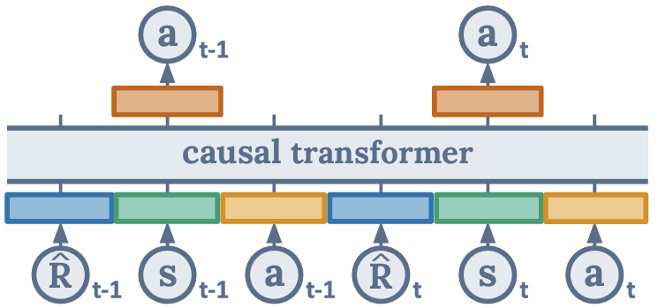
(Online) Decision Transformers (ODTs)
Decision Transformers (DT) [1] were proposed to level the gap
Brings sequence modeling & modern transformer architecture into RL
Autoregressively completes a states, actions and Returns-To-Go (RTG) sequence
Online DT (ODT) [2] was proposed for online finetuning
Online exploration via entropy term and rollouts conditioning on high RTG
Surprisingly, few follow-ups on improving online improvement ability
Dataset buffer
Set to high values during rollouts
…
Subtract ground truth reward
[1] L. Chen et al. Decision Transformer: Reinforcement Learning via Sequence Modeling. In NeurIPS, 2021.
[2] Q. Zheng et al. Online Decision Transformer. In ICML, 2022.
Department of Computer Science
GRAINGER COLLEGE OF ENGINEERING
Notes:
To level the gap between RL and the other communities, decision transformers have been proposed. They introduce the sequence modeling paradigm and modern transformer architectures into RL. Different from prior RL frameworks, decision transformers process an agent trajectory as a sequence of states, actions and returns-to-go (RTGs), where RTGs means future cumulative total reward. The decision transformer is trained autoregressively to complete the actions in this sequence.
However, this autoregressive paradigm is designed for offline training, which is not enough; often, the agent needs online finetuning, to interact with the environment directly and explore better choices that are not shown in offline data. Therefore, the online decision transformer was proposed; it conducts online exploration by adding an entropy term, and more importantly, by conditioning its trajectory generation on high RTGs during rollouts. The autoregressive dataset will be replenished by those conditionally generated trajectories.
Surprisingly, though offline-to-online finetuning is a very important and popular topic in reinforcement learning in recent years, there is very few work that improves the online finetuning ability of ODT. To analyze and address its performance is the motivation of our work.

Slide 4
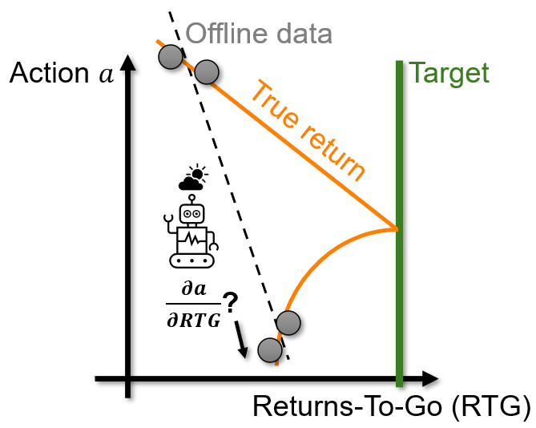
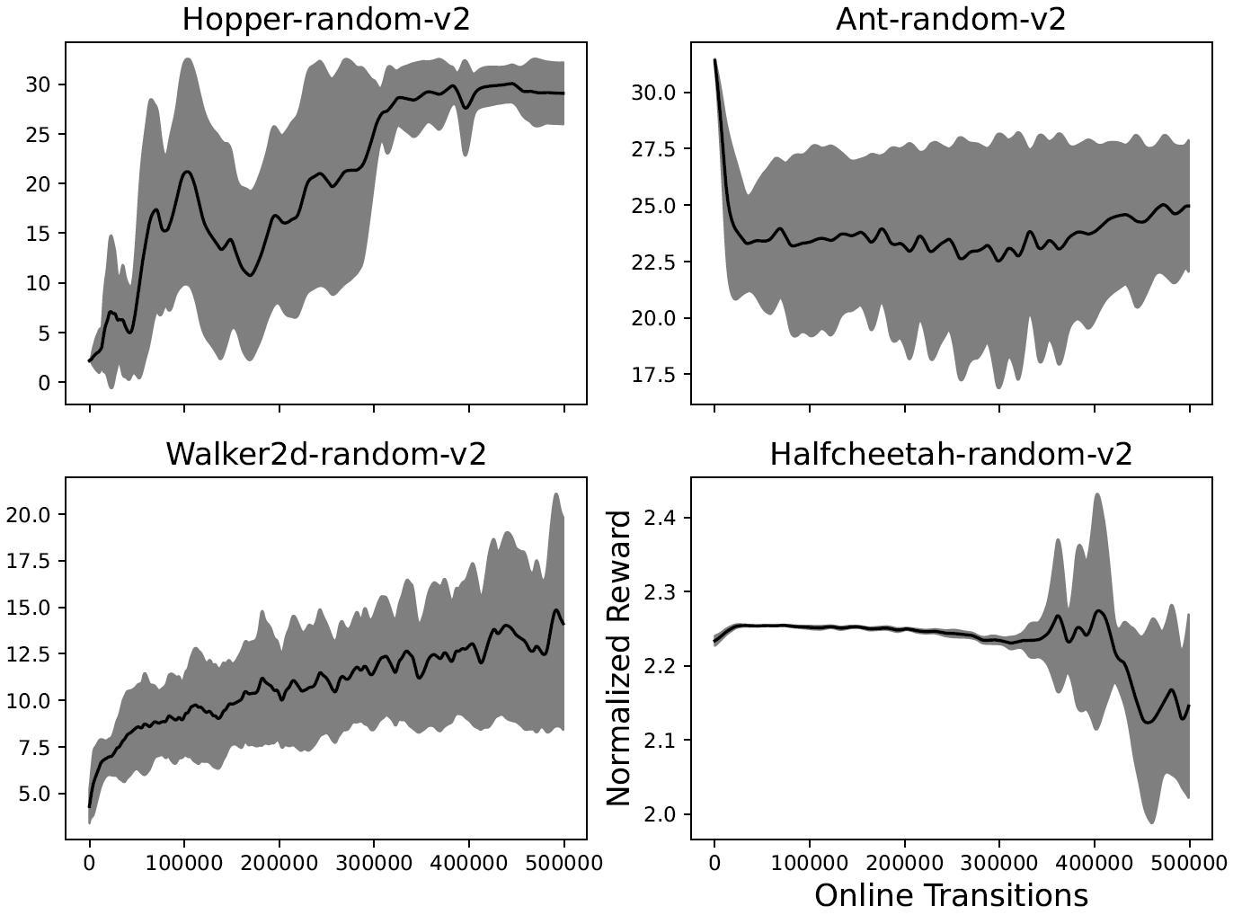
ODTs Online Improvement Deficiency Disease
ODT fails to improve during online finetuning after pretraining on low RTG data
“High RTG” is too out-of-distribution and ODT can’t improve its policy locally in action space
Check theoretical bounds for this in our paper
Finetune after pretraining on random dataset;
struggle to approach expert-level reward of 100!
Image Source: Internet
Department of Computer Science
GRAINGER COLLEGE OF ENGINEERING
Notes:
More specifically, we find ODT has an “online improvement deficiency syndrome”, which means it struggles to improve during online finetuning after pretraining on data with low RTGs. Here is a result of finetuning ODT on MuJoCo environments after pretraining on dataset with random transitions; we clearly observe that in none of the environments, ODT’s performance after finetuning comes close to an expert level, which is 100.
So, why does this happen? It is because of the “conditioning on high RTGs during the online stage”. If the average RTG is too low during pretraining, then conditioning on high RTG is very out-of-distribution and thus will not lead to actions that indeed result in higher RTGs. As shown in the figure on the right, even in a simple single-state, one-dimensional action MDP, the true direction for RTG improvement could be misled by low-quality offline data. And worse still, ODT cannot improve its policy locally in the action space either, because the architecture of the transformer only gives us the gradient of the action with respect to RTG; but for improvement in local action space, we will need the opposite, that is the gradient of RTG with respect to the action. We also established theoretical bounds for this out of distribution issue in our paper.

Slide 5
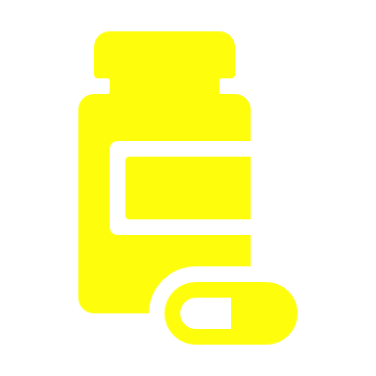
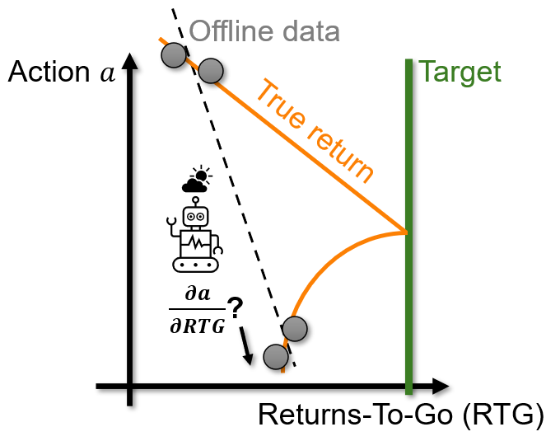
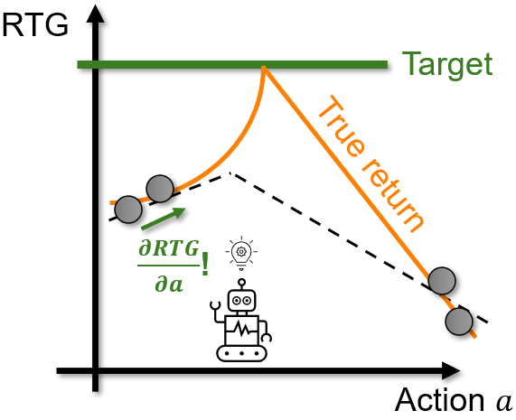
Can a Small Dose of RL Gradients Cure?
We need to enable ODT to improve RTG in local action space
This is exactly what RL does!
We found TD3 to be the best choice
RL gradient
ODT
TD3+ODT
Department of Computer Science
GRAINGER COLLEGE OF ENGINEERING
Notes:
As we have located the disease, the next question is, what is the cure? The answer is very simple. Since we know that ODT cannot improve locally in action space, we will need a method that enables ODT to improve its RTG in local action space. Fortunately, “improving in local action space” is exactly what RL does. The value function provides a gradient of RTG with respect to action. This gradient can come from any RL algorithm. In an extensive investigation, we found that TD3 is a compelling choice. Therefore, the cure is very simple: train an MLP critic and add to the original loss a downweighted TD3 actor loss with the decision transformer as the actor. This serves as a Vitamin for curing the disease of not being able to improve from low RTG pretraining data.

Slide 6
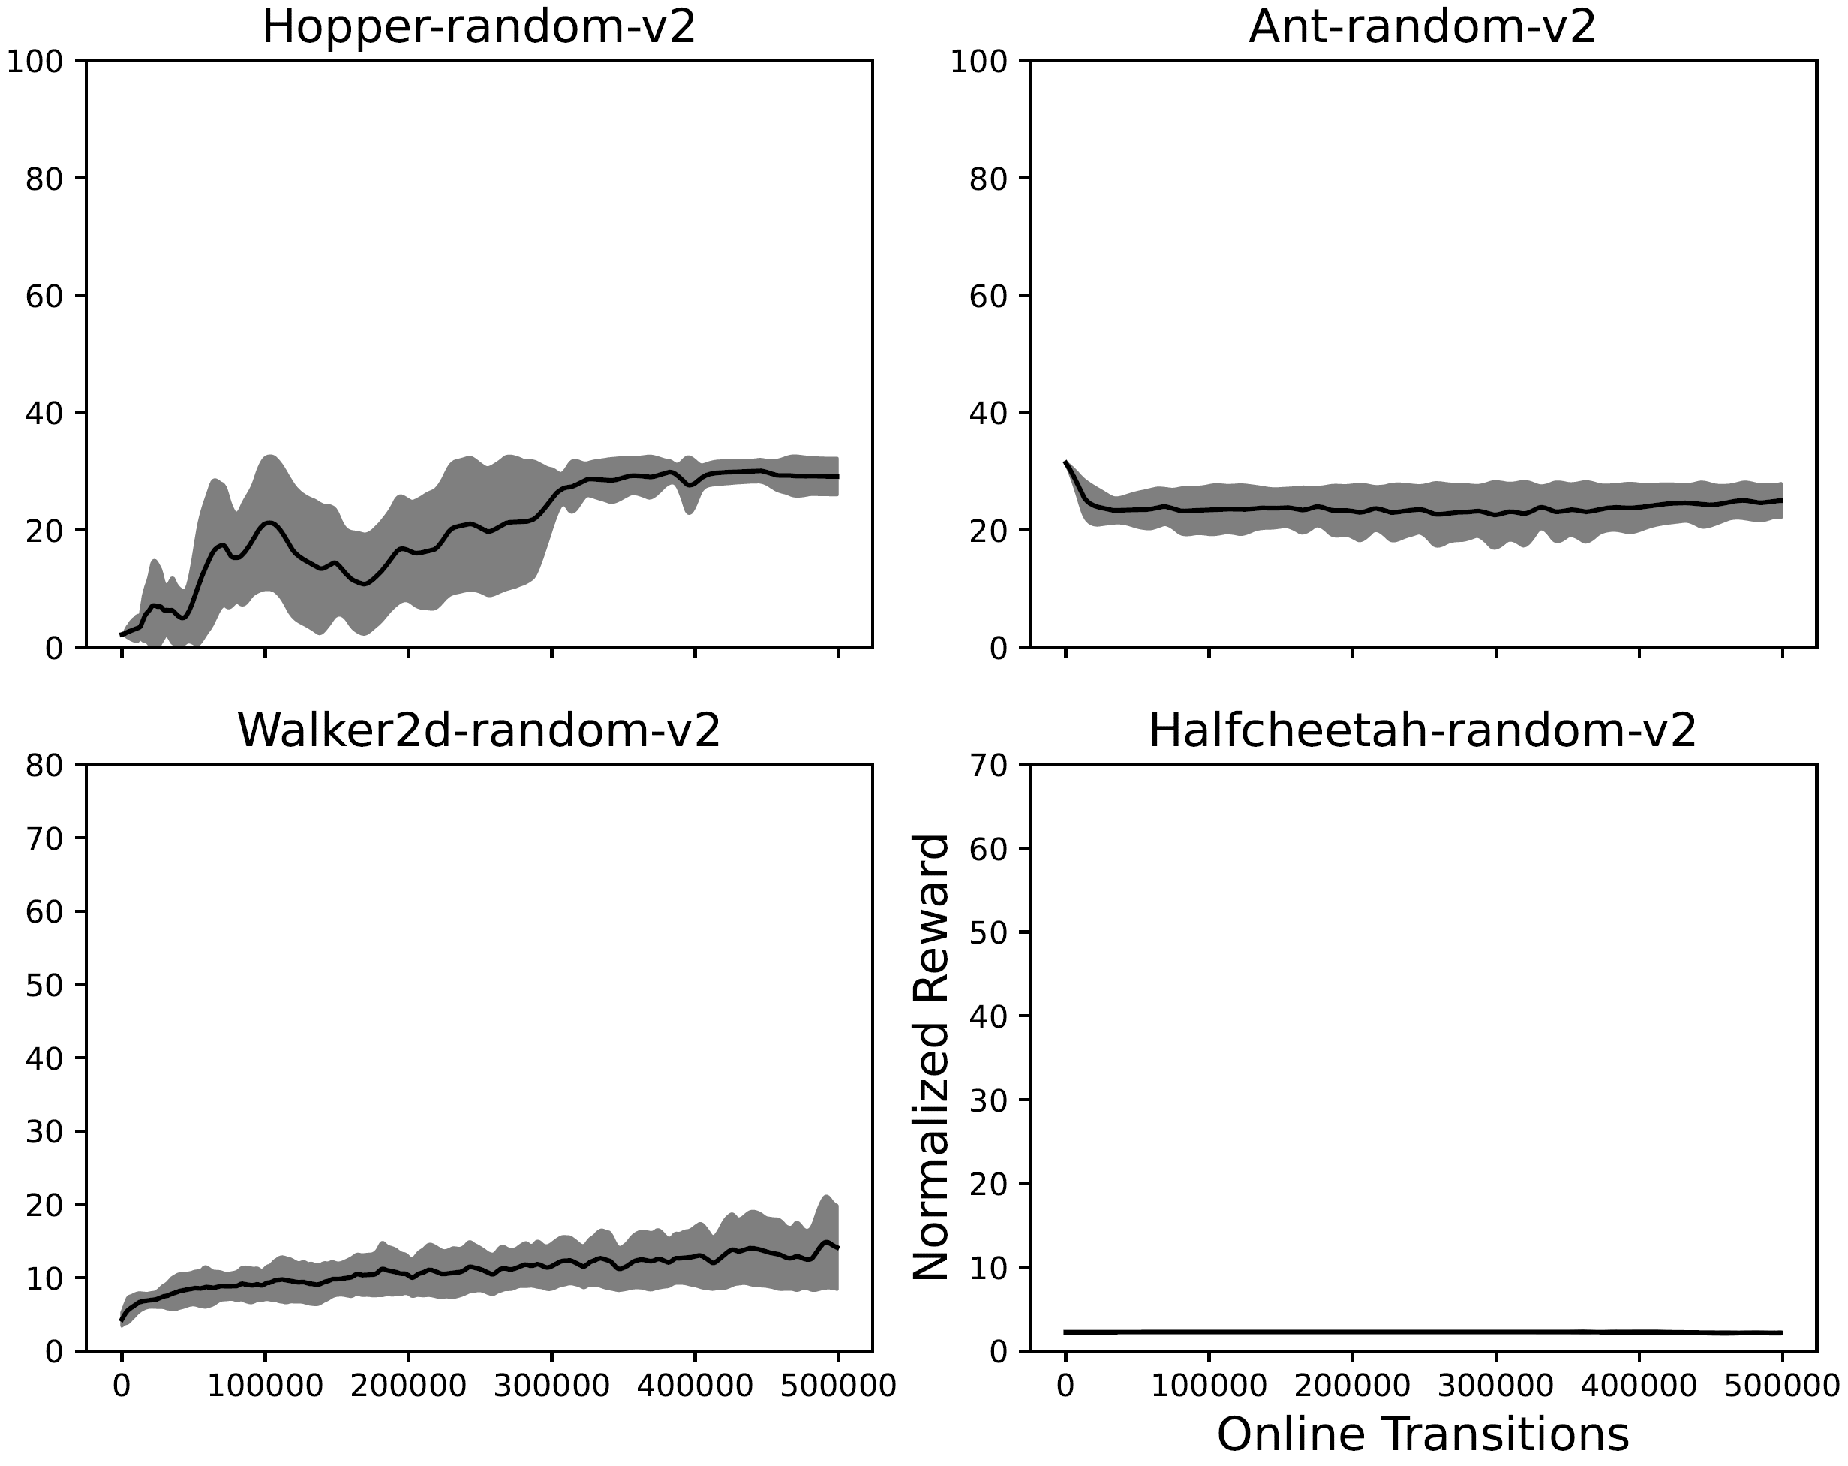
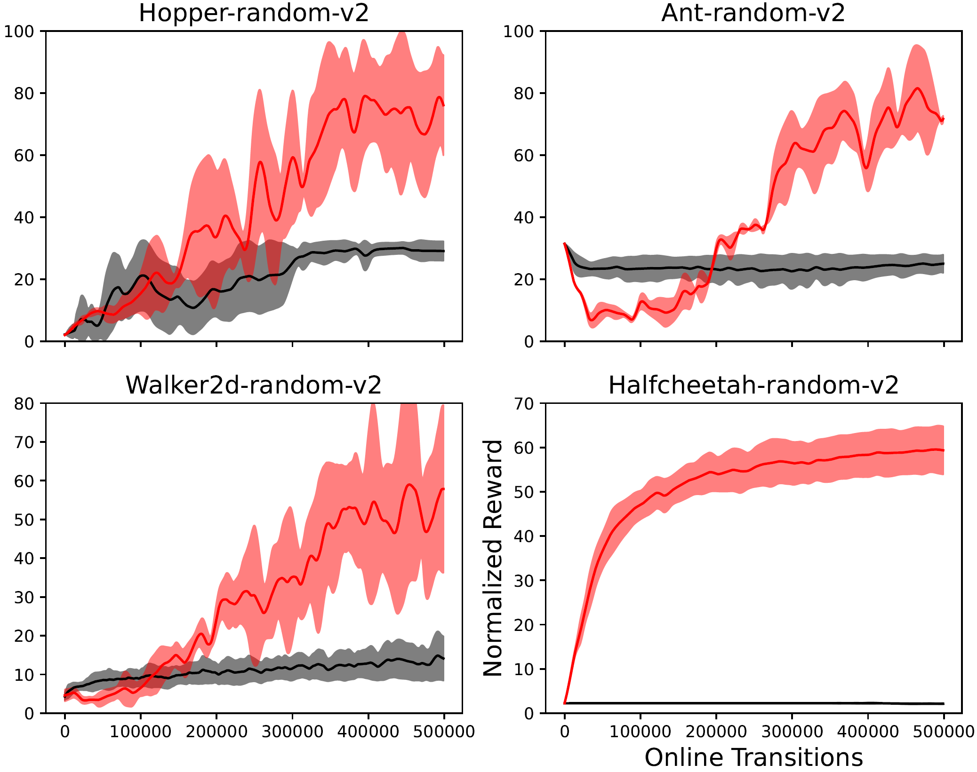
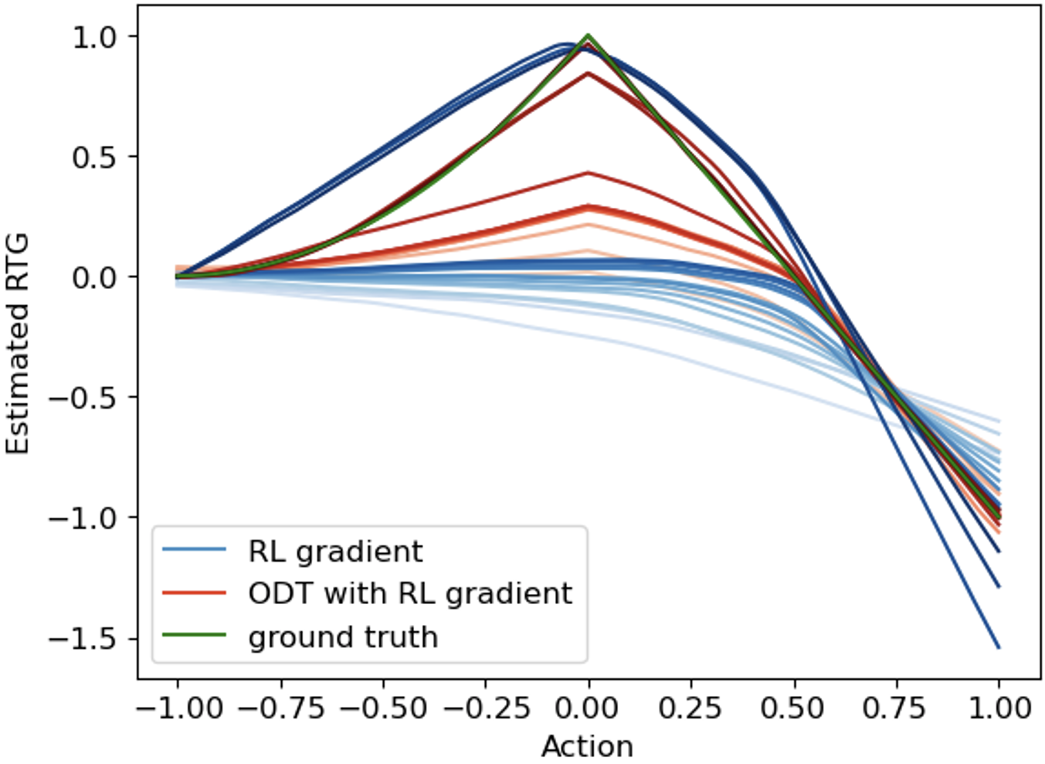
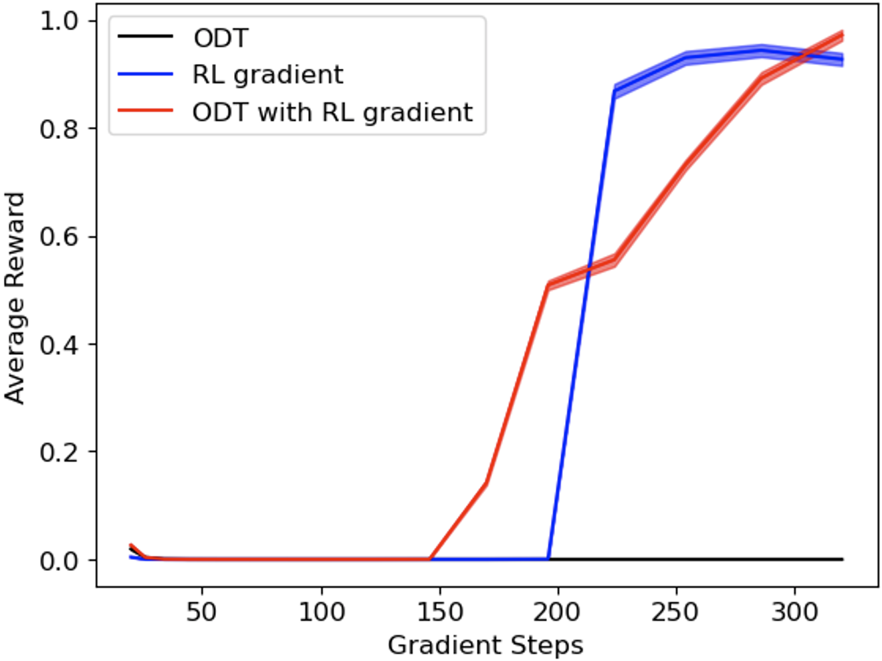
How Well Does Our Prescription Work?
TD3+ODT outperforms many baselines on a variety of tasks
Especially after pretraining on low-RTG data!
TD3
Offline data coverage
Find hidden peak!
Ours vs. ODT on finetune with
pretraining on MuJoCo random dataset
Reward curves on solving the simple single-state MDP
Department of Computer Science
GRAINGER COLLEGE OF ENGINEERING
Notes:
After introducing diagnosis and treatments for ODT, the obvious next question targets efficacy of our prescription. We start by showing a comparison between our method and ODT on the two cases we discusses earlier: the first case is the finetuning on random MuJoCo data, which clearly shows that our solution can greatly improve the ability of online finetuning ODT upon pretraining with random data. The second case is the single-state MDP with hidden reward peak. It is again evident that our solution discovers the hidden, true direction for policy improvement.

Slide 7
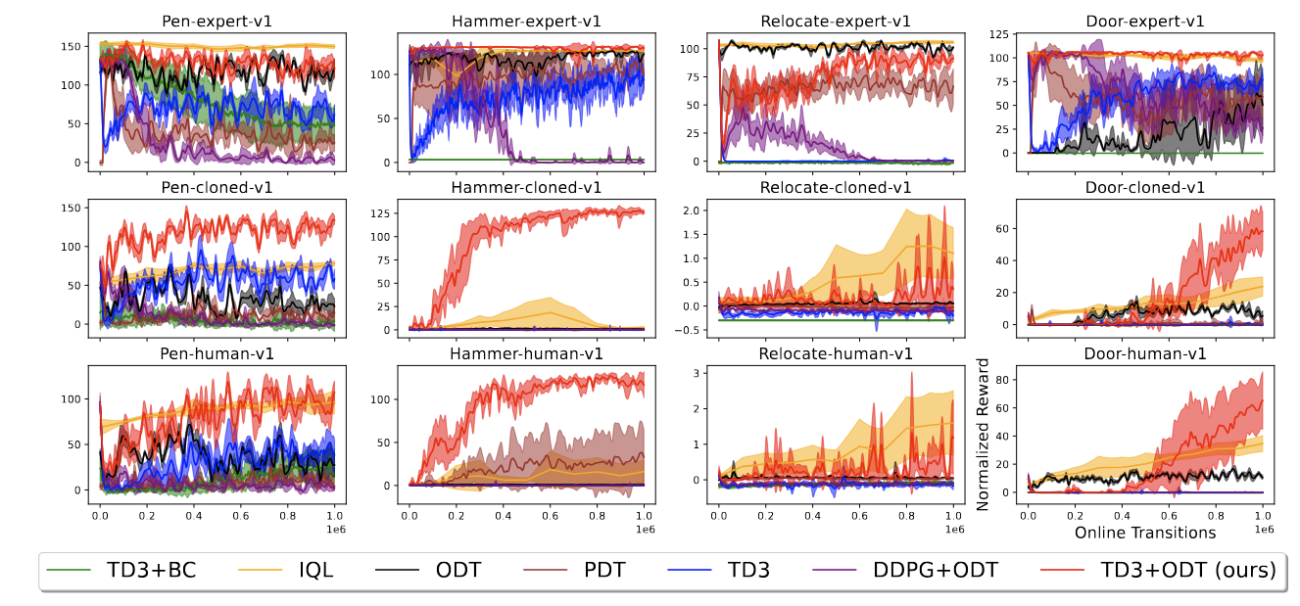
How Well Does Our Prescription Work?
TD3+ODT outperforms many baselines on a variety of tasks
Tasks: Adroit, MuJoCo, antmaze & maze2d (30+ different dataset-environment pairs)
See our paper for 10+ detailed ablation studies
Reward curves on adroit (Higher is better); our method highlighted in red
Department of Computer Science
GRAINGER COLLEGE OF ENGINEERING
Notes:
We have further tested our solution on a variety of tasks, including adroit, MuJoCo, antmaze and maze2d with more than 30 different dataset-environment pairs; here we show that our method outperforms all baselines on the complicated adroit task with reward curves, where our method is highlighted in red. We also have a great amount of ablation studies which you can find in the paper.

Slide 8
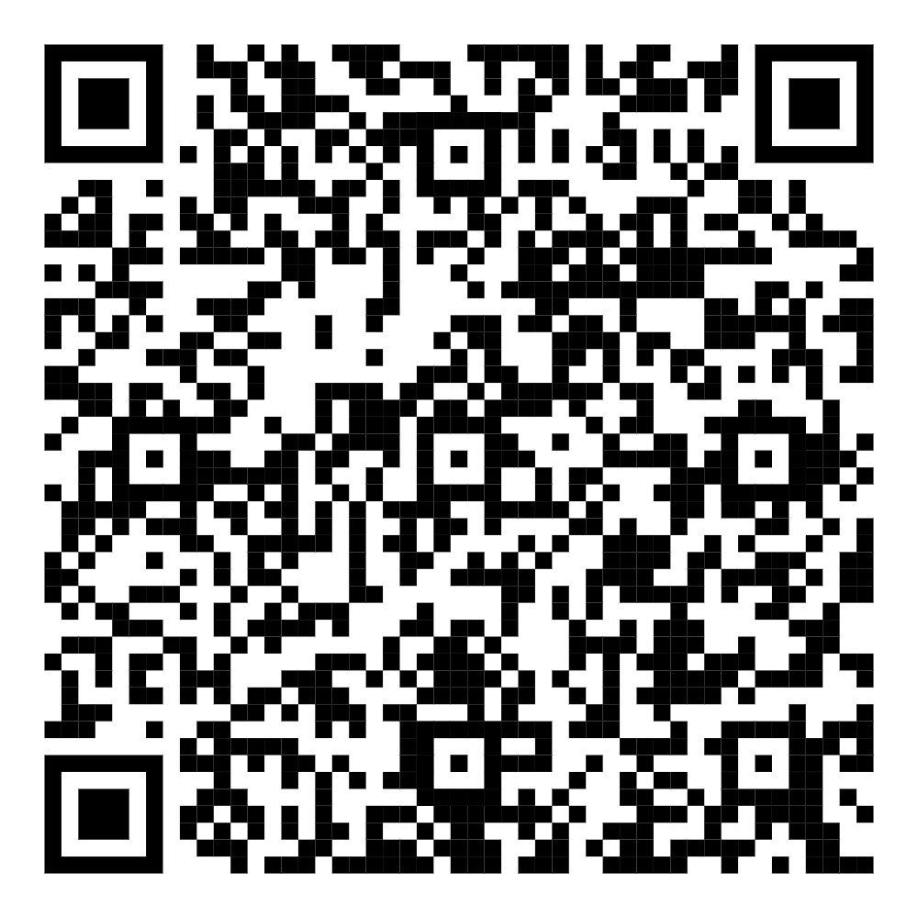
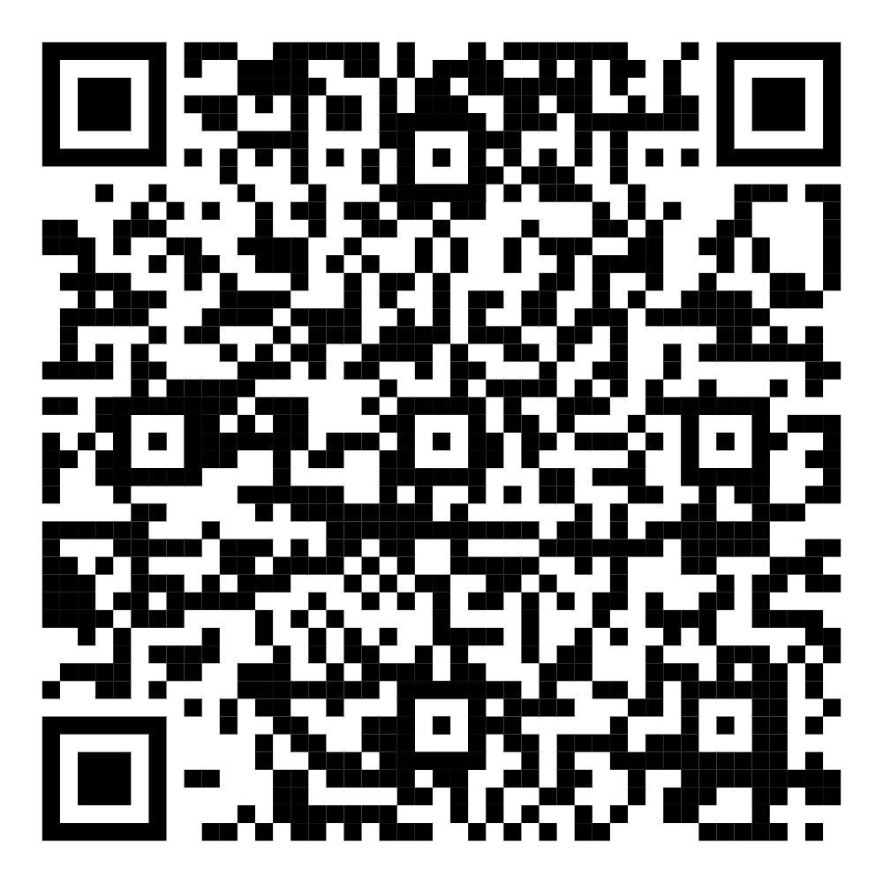
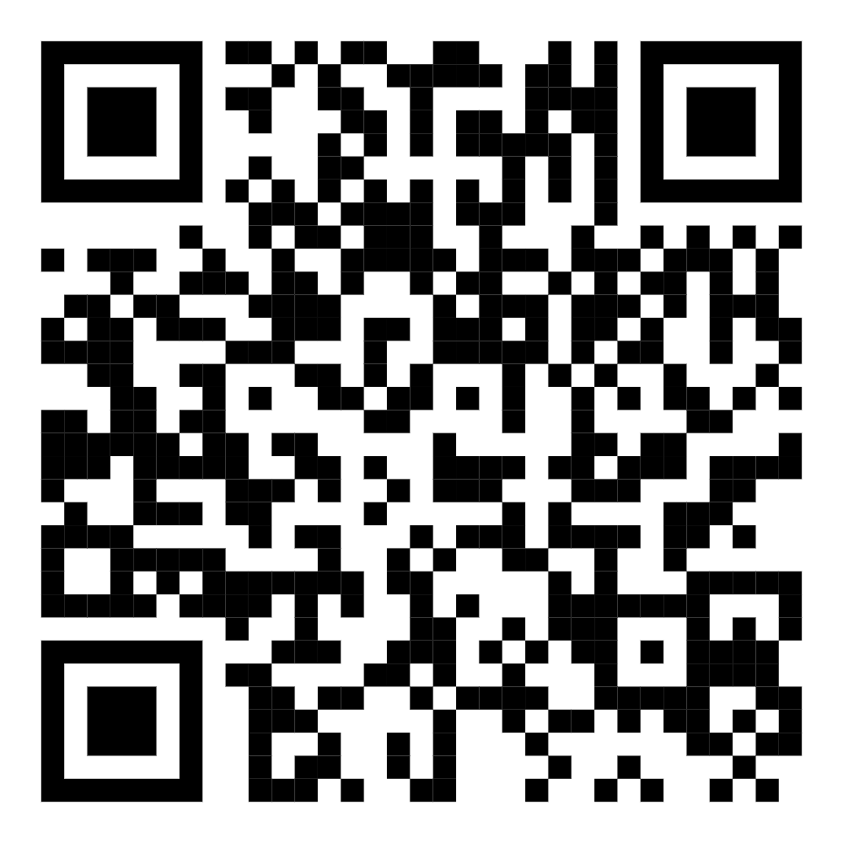
Thank you!
Feel free to contact kaiyan3@illinois.edu for any questions!
Code repository
Website
PDF of our paper
https://github.com/KaiYan289/
RL_as_Vitamin_for_Online_Decision_Transformers
https://t.ly/LR7pE
arXiv: 2410.24108
Department of Computer Science
GRAINGER COLLEGE OF ENGINEERING
Notes:
Please scan the QR code for more information about our code repository, website and paper. Thanks for listening!

